Slide 1
Archimedes of Syracuse
287 - 212 BC
Journey Through Genius Pp 84
Notes:
Euclid and Archimedes were separated by two or three generations
After Archimedes days the world would not see a great mathematician like him for 2000 years
Many of his mathematical works and prefaces have survived through history, fortunately
He is the son of an Astronomer and was studying the skies from a young age
He also spent some time in Egypt and studied at the great Library of Alexandria, the base of Euclid’s operations, he was trained in the Euclidean tradition
One of his early inventions is called the “Archimedean screw” a device for raising water which is still used today
The dual nature of Archimedes’ genius: the practical, down-to-earth matters, or could delve into the most abstract, ethereal realm
Archimedes chose to return to his hometown of Syracuse despite the scholarly nature of Alexandria
His mathematical talent was augmented by his ability to approach any problem at hand with periods of intense, focused concentration, more mundane concerns of life were ignored
**insert passage from Plutarch**
Archimedes was called on by King Hieron for his scientific mind: once in wanting to discover whether or not his goldsmith had given him a lesser alloy instead of gold, that’s how Archimedes discovered the fundamental principles of hydrostatic, leaving a treatise titles On Floating Bodies about this topic
He advanced the science of optics and did pioneering work in mechanics, with his water pump and his work with levers, pulleys and compound pulleys
When Rome, under the leadership of Marcellus attacked Syracuse, Archimedes defended his homeland by designing weaponry of great effectiveness -- a one-man military-industrial complex
**suggest the students read the bit on Plutarch’s writings on Marcellus and Archimedes at war**
“In this transport of study and contemplation, a soldier, unexpectedly coming up to him, commanded him to follow Marcellus; which he declining to do before he had worked out his problem to a demonstration, the soldier, enraged, drew his sword and ran him through,” Plutarch on Archimedes death in his writings of Marcellus.
“He died as he had lived, lost in thought about his beloved mathematics,” JTG 88
Of all his practical inventions and scientific discoveries, his true passion was mathematics

Slide 2
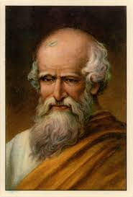
Archimedes
The world would not see another mathematicians as great as him for another 2000 years
He is the son of an astronomer
He spent time in Egypt and studied at the great Library of Alexandria, he was trained in the Euclidean tradition
Invented the “Archimedean screw” -- he had a dual nature to his work, both the most practical and most abstract

Slide 3
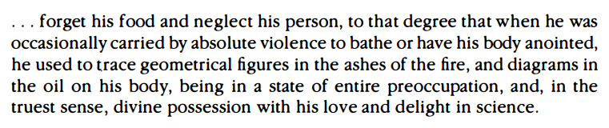
Talent and Contributions
He was able to approach any problem with periods of intense, focused concentration, more mundane concerns of life were ignored
Called on by King Hieron
Advanced the science of optics
Did pioneering work in mechanics with his water pump and his work with levers, pulleys, and compound pulleys
When Rome attacked Syracuse, Archimedes defended his home by designing highly effective weaponry
**suggested reading, on Marcellus and Archimedes

Slide 4
“In this transport of study and contemplation, a soldier, unexpectedly coming up to him, commanded him to follow Marcellus; which he declining to do before he had worked out his problem to a demonstration, the soldier, enraged, drew his sword and ran him through,” Plutarch on Archimedes death in his writings of Marcellus.

Slide 5
“He died as he had lived, lost in thought about his beloved mathematics.”
Of all his practical inventions and scientific discoveries, his true passion was mathematics.
Journey Through Genius
Pp. 88

